Slide 1




Sales Dataset Analysis – Advanced Excel Project
VASANTH MG
16TH DECEMBER 2024
DA AND DS
NOV BATCH

Slide 2
Project Overview & Objectives
Overall purpose of the project
Analyzing sales data
Determining the impacts
Insights about the performances
To get a better view about the inputs

Slide 3
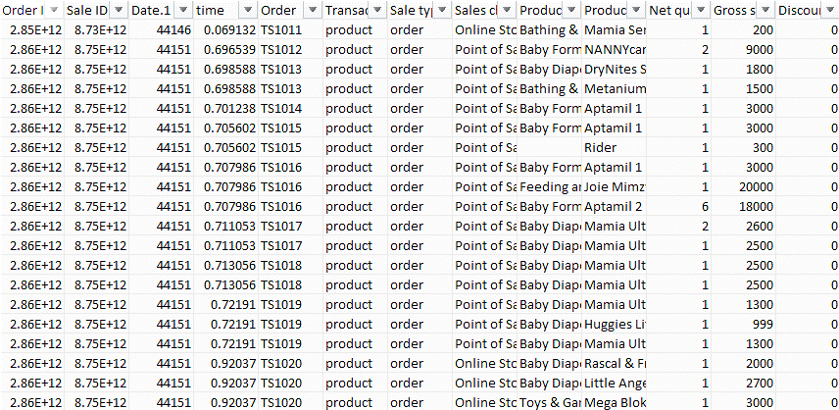
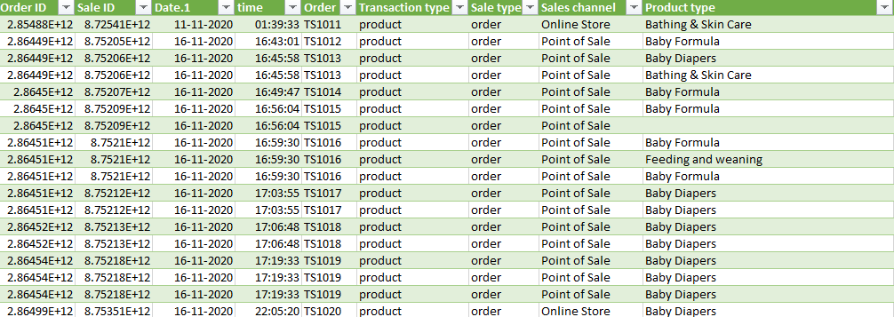
Data Description and Preparation
Dataset Overview
Data Cleaning Process
Visuals
Raw data
Cleaned data

Slide 4
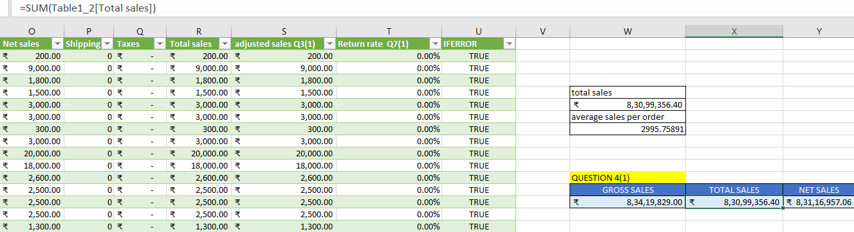
Key Metrics Calculation and Data Analysis
Important Calculations: key metrics
Total sales-Net sales-Gross sales
Average sales per order
Discount rates, return rates

Slide 5
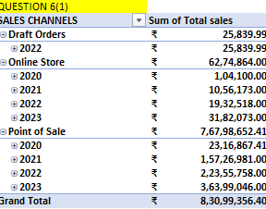
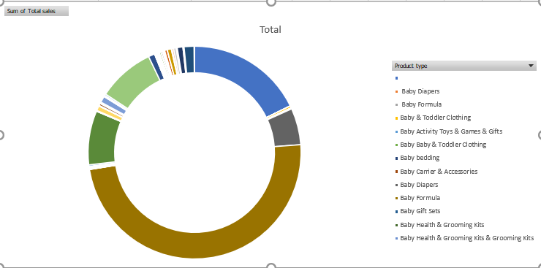
Pivot Tables and Pivot Charts
Pivot Table Summary
Pivot Chart Visualizations
Visuals
Pivot table
Pivot chart

Slide 6
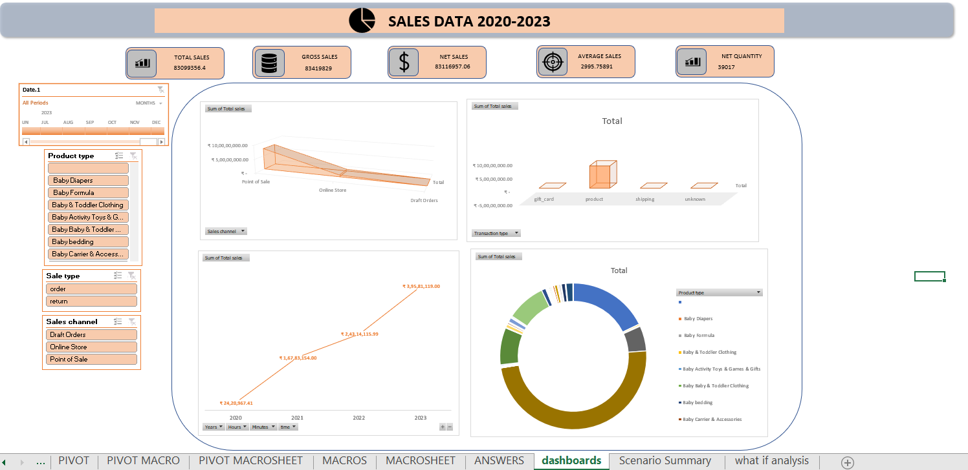
Dashboard Overview
Dashboard Design
KPIs
Visuals
Dashboards

Slide 7
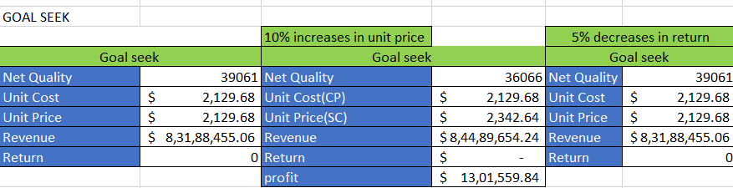
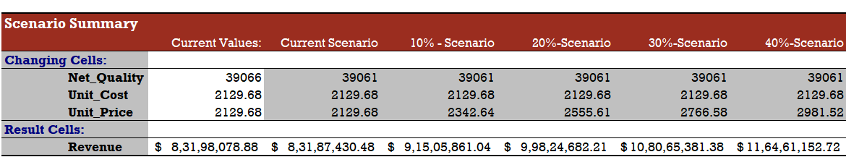
What-If Analysis & Goal Seek
What-If Scenarios
Goal Seek
visuals
Goal seek
Scenario manager

Slide 8
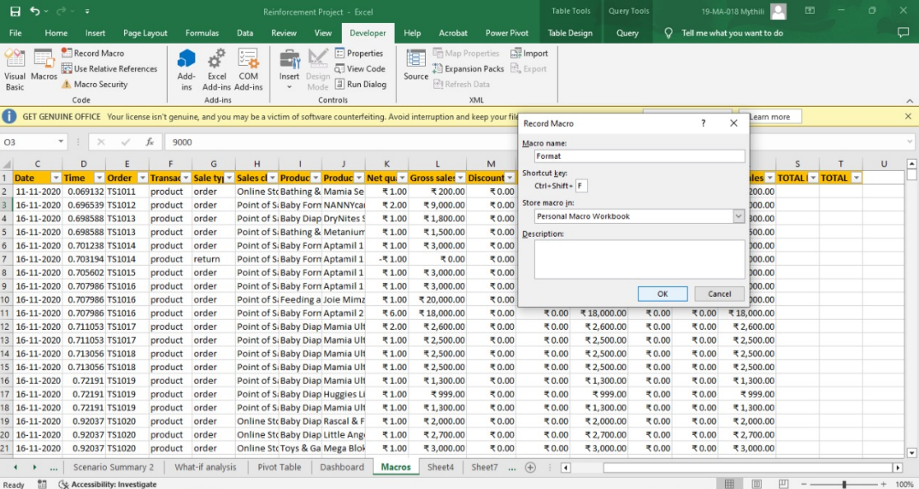
Macros and Automation
Macro Recording
Automation Benefits
visuals

Slide 9
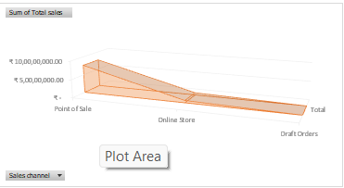
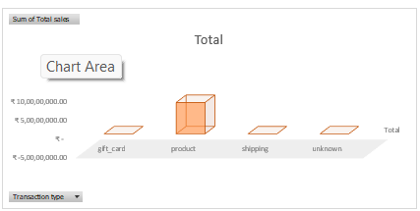
Insights and Recommendations

Slide 10
Conclusions
TAKEAWAYS AND CONCLUSIONS:
RECOMMENDATIONS
PEAK PERFORMANCE
SALES BY MONTH
CHANNELS
TRANSACTION TYPE
THANK YOU

